Slide 1


Consumer Goods Ad_Hoc Insights

Slide 2
Project Overview
Project Title Consumer Goods Sales Analysis – Ad Hoc Business Requests.
Objective Analyze the consumer goods dataset using SQL to solve business ad-hoc requests and extract meaningful insights related to products, customers, and sales performance.
Dataset Consumer Goods Sales dataset containing product, customer, sales, and pricing data across multiple markets and fiscal years.
Tools Used
MySQL
Excel
PowerPoint
Key Analysis Areas
Product growth analysis
Customer discount analysis
Sales trends (monthly & quarterly)
Channel contribution
Top performing products
Total Ad-Hoc Requests Solved 10 Business Questions

Slide 3
Dataset Structure
Dimension Tables
• dim_customer – Customer details
• dim_product – Product information
Fact Tables
• fact_sales_monthly – Monthly sales transactions
• fact_gross_price – Product pricing
• fact_manufacturing_cost – Manufacturing cost
• fact_pre_invoice_deductions – Customer discounts
Data Model
Star Schema (dimension tables connected with fact tables)

Slide 4
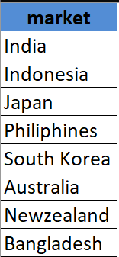
Yearly report for ‘croma’ customer
Question
1. Provide the list of markets in which customer "Atliq Exclusive" operates its business in the APAC region.
Output

Slide 5
Question No. 2
2. What is the percentage of unique product increase in 2021 vs. 2020? The final output contains these fields, unique_products_2020 unique_products_2021 percentage_chg
Output

Slide 6
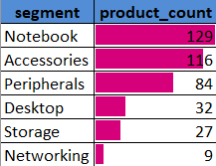
Question No. 3
3. Provide a report with all the unique product counts for each segment and sort them in descending order of product counts. The final output contains 2 fields, segment product_count Output

Slide 7
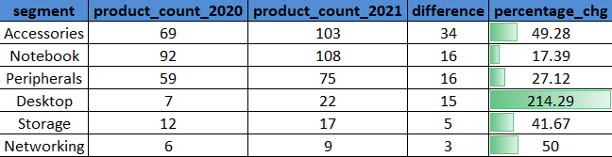
Question No. 4
4. Follow-up: Which segment had the most increase in unique products in 2021 vs 2020? The final output contains these fields, segment product_count_2020 product_count_2021 difference
Output

Slide 8

Question No. 5
5. Get the products that have the highest and lowest manufacturing costs. The final output should contain these fields, product_code product manufacturing_cost Output

Slide 9
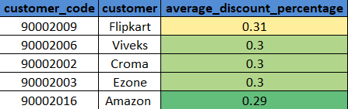
Question No. 6
6. Generate a report which contains the top 5 customers who received an average high pre_invoice_discount_pct for the fiscal year 2021 and in the Indian market. The final output contains these fields, customer_code customer average_discount_percentage Output

Slide 10
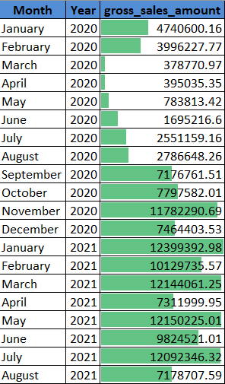
Question No. 7
7. Get the complete report of the Gross sales amount for the customer “Atliq Exclusive” for each month . This analysis helps to get an idea of low and high-performing months and take strategic decisions. The final report contains these columns: Month Year Gross sales Amount Output

Slide 11
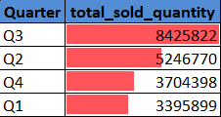
Question No. 8
8. In which quarter of 2020, got the maximum total_sold_quantity? The final output contains these fields sorted by the total_sold_quantity, Quarter total_sold_quantity Output

Slide 12

Question No. 9
9. Which channel helped to bring more gross sales in the fiscal year 2021 and the percentage of contribution? The final output contains these fields, channel gross_sales_mln percentage
Output

Slide 13
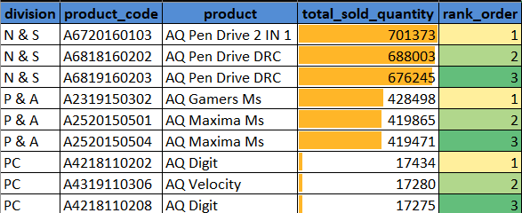
Question No. 10
10. Get the Top 3 products in each division that have a high total_sold_quantity in the fiscal_year 2021? The final output contains these fields, division product_code
Output

